Slide 1


Field Vice President
(Earned in excess of US$36,000
in 4 week pay cycle)
  Million Dollar Club Member
  Market America Advisory Council
  Market Singapore Leadership Council
  Certified Trainer
  Speakers’ Bureau Category II
  Top Recruiter/Top Retailer Awards
  Fastest Growing Award – MAIC 2014

Slide 2

Notes:
The Road Less Travelled – Robert Frost
I took the road less travelled
Brief account of my story from Australia to Singapore
Lessons I learned along the way…
Story : Journey to the Amazon Forest

Slide 3


Two roads diverged in a wood,
and I took the one less traveled by,
and that has made
all the difference.
The Greatest Showman
Notes:
Keys to Success :
PASSION (not in slide)
Story of the Greatest Showman
Story of Phineas, son of a humble tailor
Had grand dreams to change the world
Look at the lyrics… How relevant is this to MA?

Slide 4
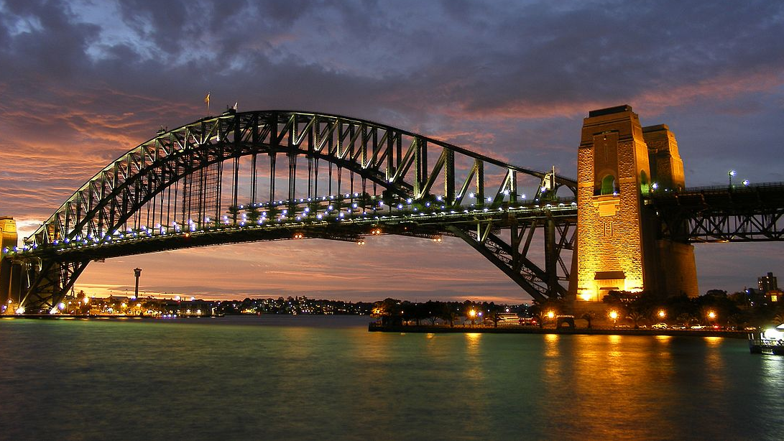

Where the adventure began
Notes:
Unlikely candidate…

Slide 5
Lessons along the way…
Notes:
Unlikely candidate…

Slide 6

embrace
learning
Liken to a
university education…
Notes:
Unlikely candidate…

Slide 7
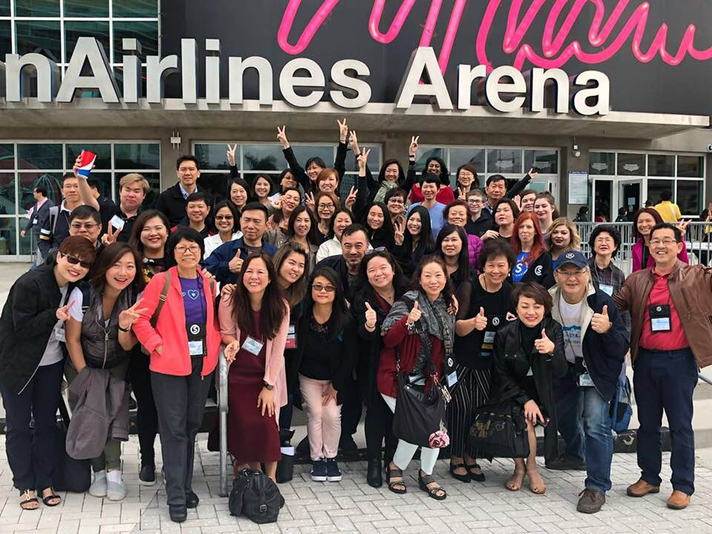
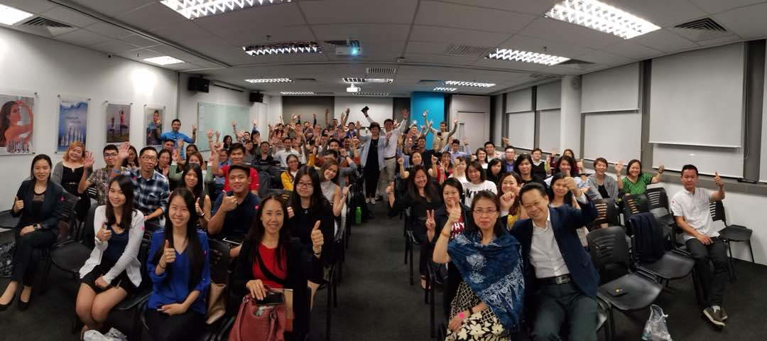

Go to events!
Notes:
Pam Bowling in her segment at MAIC 2018, says,
GMTSS is the passport to education, belief, hope and faith.
It keeps your people trained…
**Imagine the time when you are unable to do so,
like her caring for Tony who has been ill for months
Without attending events, you’ll disappear
** Always say this to in my corings, if you don’t buy tickets,
if you do’t show up at events, it’s a matter of time, that you will slowly fade….
Do you, like me, feel the ache in your hearts, when you attend an event,
and just wish that somebody you care about is there with you?
Does it cause pain in your chest, like it did to me?
I then realise that I want it MORE for them, than they want for themselves!
nd then I try to release it….work with those who believe in ongoing education like you.

Slide 8

without
attending
events...
you’ll
disappear
Notes:
• Way to lead
• Duplication
• Team growth
• Gain belief to keep moving on
It’s your commitment to success

Slide 9


The Uniqueness
The Privileges
to education, belief, hope & faith
Notes:
Pam Bowling in her segment at MAIC 2018, says,
GMTSS is the passport to education, belief, hope and faith.
It keeps your people trained…
**Imagine the time when you are unable to do so,
like her caring for Tony who has been ill for months
Without attending events, you’ll disappear
** Always say this to in my corings, if you don’t buy tickets,
if you do’t show up at events, it’s a matter of time, that you will slowly fade….
Do you, like me, feel the ache in your hearts, when you attend an event,
and just wish that somebody you care about is there with you?
Does it cause pain in your chest, like it did to me?
I then realise that I want it MORE for them, than they want for themselves!
nd then I try to release it….work with those who believe in ongoing education like you.

Slide 10
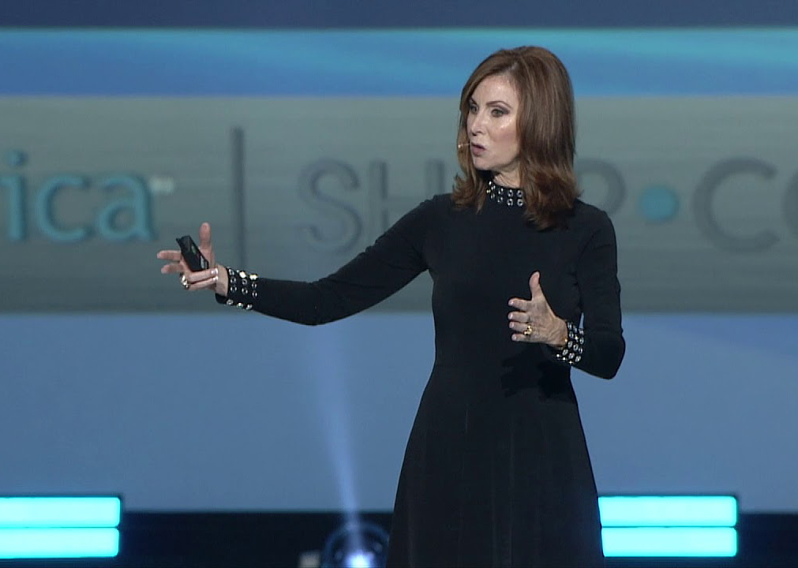
Pam Bowling • MAIC 2018
“ GMTSS keeps
your people
trained…”
Notes:
Jim Collins, a Management Guru
He and his research team studied outstanding business leaders.
They started the work expecting to find that great transformational leaders
would start with vision and strategy.
Instead, they found that leaders.

Slide 11
Become
A Better U

Slide 12
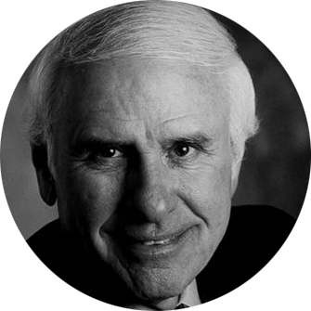
“Successful people do
what unsuccessful people
are not willing to do.
Don’t wish it were easier, just wish you were better!” JIM ROHN
Notes:
Leaders have vision-never lose focus.
Single-minded about what it’s after.

Slide 13
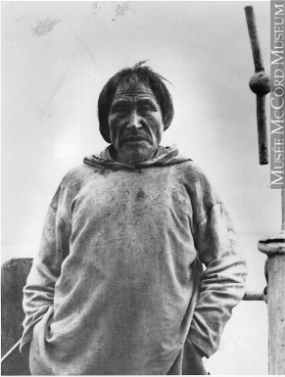
You can’t climb the ladder
of success
with your hands
in your pockets
Notes:
Recent Headlines
USE PHOTOS
ASEAN to become world’s fourth largest economy by 2030 – Singapore PM Lee
Singapore firms must team up to expand abroad, says Heng
HOW DO WE EXPAND THIS MARKET?
The only way forward is solidarity and unity of purpose!

Slide 14
Face your Challenges

Slide 15

!
Look beyond the mud
Notes:
LESSONS ON LEADERSHIP
EMBRACE LEARNING
Go to events! If you don’t, you’ll disappear!
Events help you and your teams grow!
Don’t be an armchair learner!

Slide 16
When things go wrong…
Notes:
How big are your goals?

Slide 17
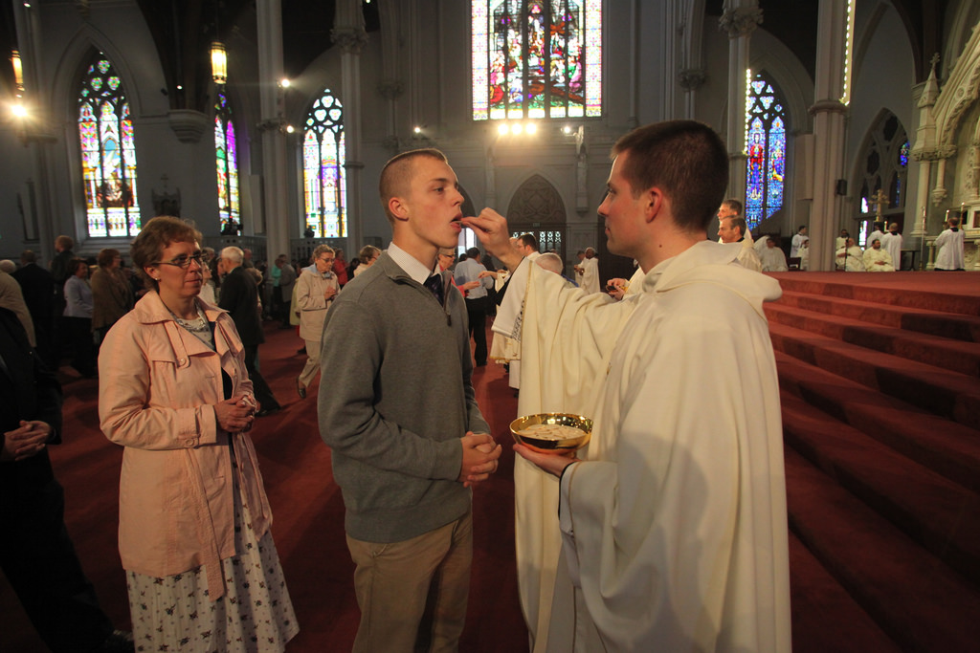
A priest giving advice to a young novice about 3 things when living in a community…
Notes:
How big are your goals?

Slide 18
1st – you are not God!
2nd – this isn’t heaven!
3rd – Just let it go!
Notes:
How big are your goals?

Slide 19
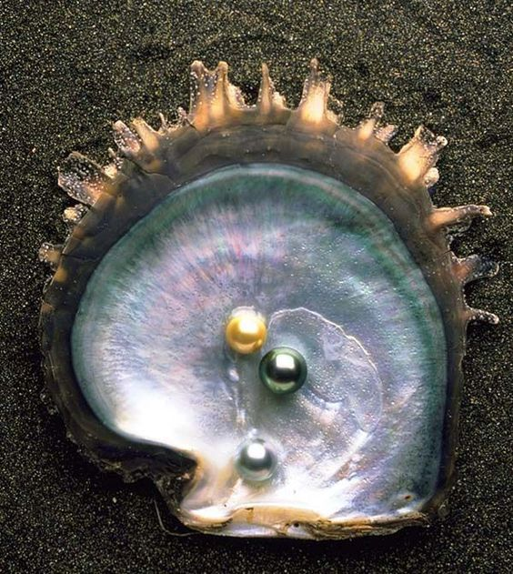
Obstacles
help you
Grow!
Notes:
Look at the oyster and the pearl
The obstacles help you grow!

Slide 20

Notes:
Look at the oyster and the pearl
The obstacles help you grow!

Slide 21

Notes:
Pursuit for the opening of MARKET SINGAPORE AND MARKET MALAYSIA
(SHOW THE PROPOSALS PHOTOS)
(SLIDE – PHOTOS OF MILLION DOLLAR CLUB)
They are here because they persevere and refuse to give up!

Slide 22
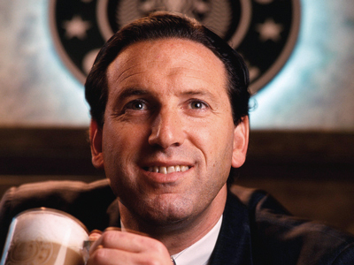
Notes:
Look at the oyster and the pearl
The obstacles help you grow!

Slide 23
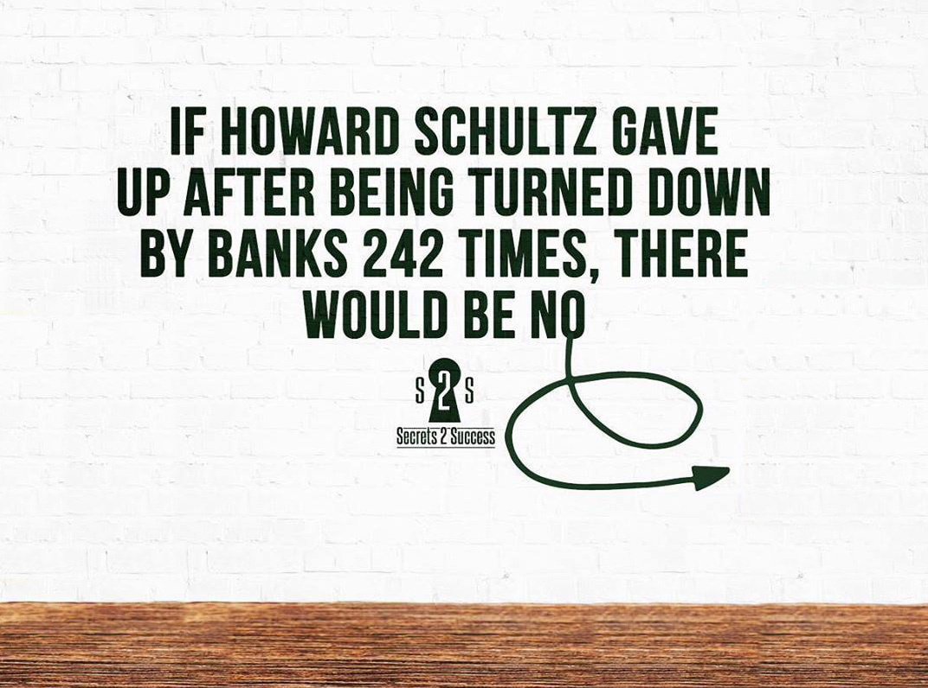

Notes:
If Howard Schultz gave up after being turned down by banks 242 times, there would be no ….(show picture of Starbucks)
Photo of Mohd Ali “I hated every minute of training, but I said, Don’t quit!” Suffer now and live the rest of your life as a champion.
When a child learns to walk and falls down 50 times, he never thinks to himself :”maybe this isn’t for me?”

Slide 24
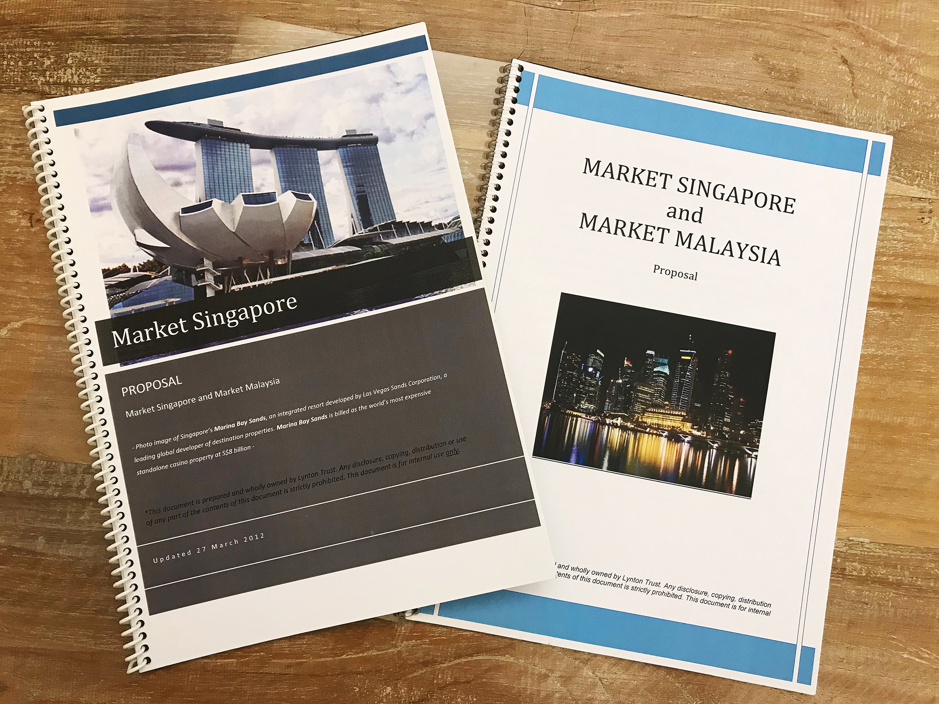
Dreams do come true!
Notes:
Pursuit for the opening of MARKET SINGAPORE AND MARKET MALAYSIA
(SHOW THE PROPOSALS PHOTOS)
(SLIDE – PHOTOS OF MILLION DOLLAR CLUB)
They are here because they persevere and refuse to give up!

Slide 25
Make meaning
of what we do!
Notes:
Carpe Diem – Let’s seize the moment
The best is yet to be!

Slide 26
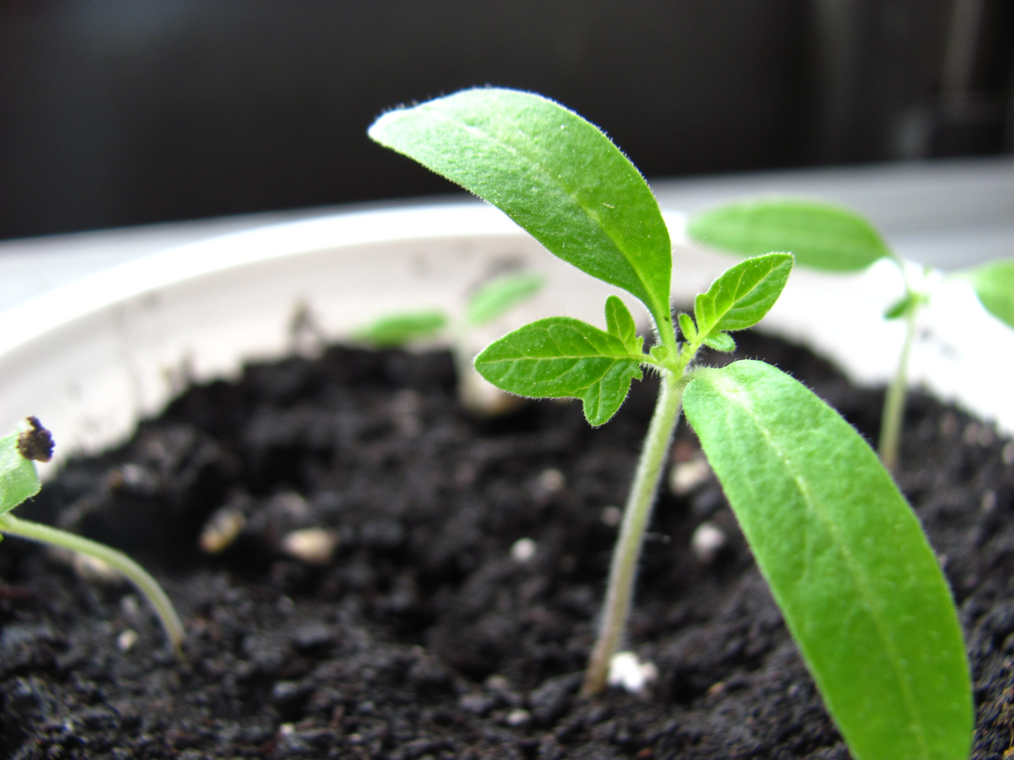
We’re meant
to grow, so we have something to give…
Anthony Robbins

Slide 27
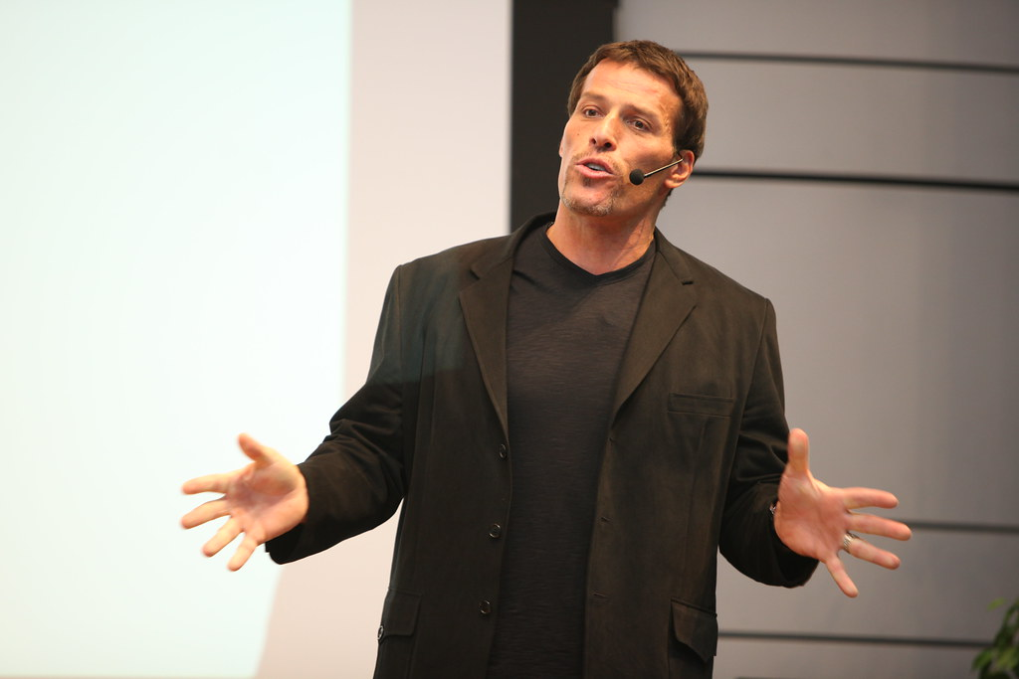
A Sense of
Contribution
“….makes all of life worthwhile. Imagine what a better world it would be if all of us cultivated a sense
of contribution.”
Anthony Robbins
Notes:
A Sense of Contribution
“A sense of contribution makes all of life worthwhile.
Imagine what a better world it would be if all of us cultivated
a sense of contribution.” Anthony Robbins – Awake the Giant Within
Look at Andrew Carnegie,
at one time the wealthiest man in America!
What was his significant contribution to society?

Slide 28
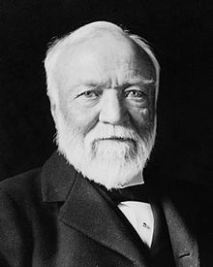
What was
his significant contribution to society?
-----------------------------
ANDREW CARNEGIE
at one time the wealthiest man in America!
Notes:
Look at Andrew Carnegie,
at one time the wealthiest man in America!
What was his significant contribution to society?
Came to America from his native Scotland. Did variety of odd jobs. Ended up eventually as the largest steel manufacturer in USA.
Great philanthropist donating current equivalent of US$400 billion to various charities, universities and libraries.
At one point, he had 43 millionaires working for him (in late 1800’s, a millionaire was a very rare person.)
When interviewed, he said he found gold out of a mountain of dust! He coached 43 employees to be millionaires!

Slide 29

Unparallel Product Brokerage company
+MPCP

Slide 30

My first USA Event

Slide 31

profound shift
in attitude or
perspective
Notes:
Look at the oyster and the pearl
The obstacles help you grow!

Slide 32

Notes:
Look at the oyster and the pearl
The obstacles help you grow!

Slide 33



Notes:
Look at the oyster and the pearl
The obstacles help you grow!

Slide 34
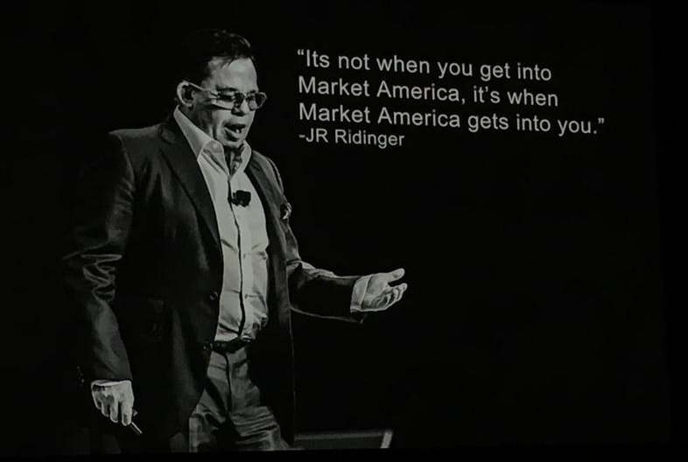

Slide 35
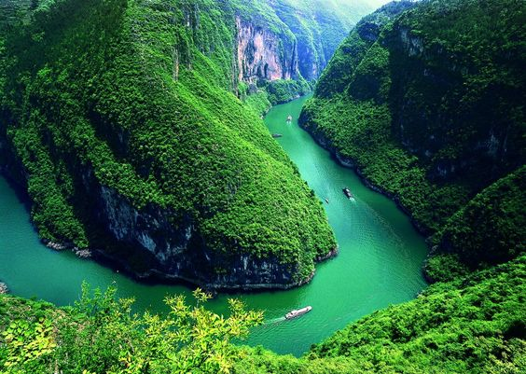
Journey to the Amazon Forest
Notes:
My first USA experience made all the difference for me
Small Investment, Big gains!
Invest in your USA trips, Leadership School, and in Local Seminars and all GMTSS events.

Slide 36
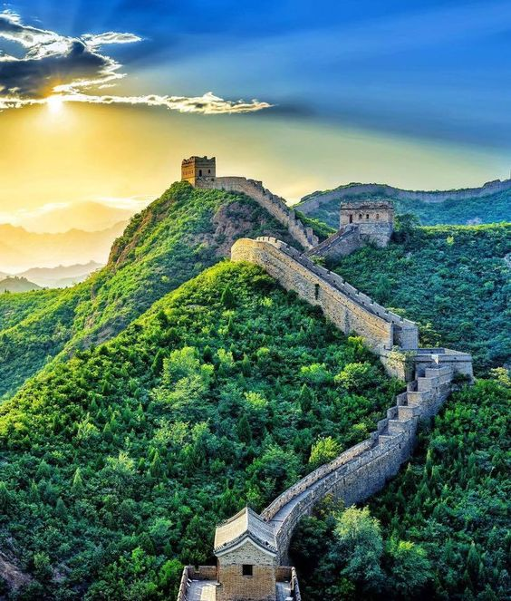
Great
Wall of CHINA
Notes:
My first USA experience made all the difference for me
Small Investment, Big gains!
Invest in your USA trips, Leadership School, and in Local Seminars and all GMTSS events.

Slide 37


Invest in..
where you want to go,
who you want to be!
Notes:
HOW DO WE EXPAND THIS MARKET?
The only way forward is solidarity and unity of purpose!
A Sense of Solidarity

Slide 38
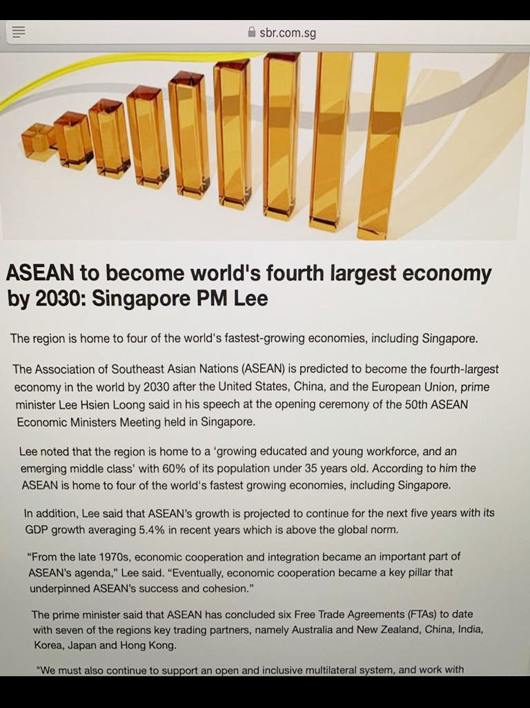
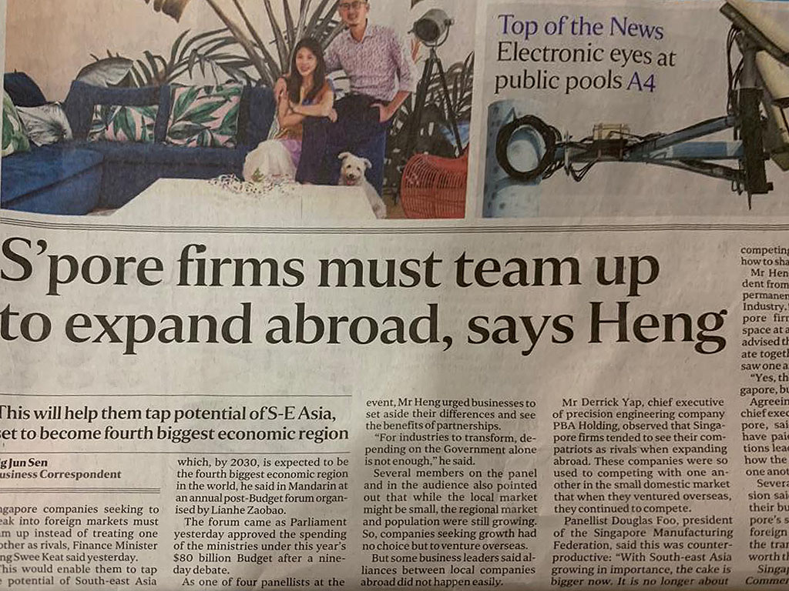
ASEAN to become world’s fourth largest economy
by 2030
Notes:
Recent Headlines
USE PHOTOS
ASEAN to become world’s fourth largest economy by 2030 – Singapore PM Lee
Singapore firms must team up to expand abroad, says Heng
HOW DO WE EXPAND THIS MARKET?
The only way forward is solidarity and unity of purpose!

Slide 39
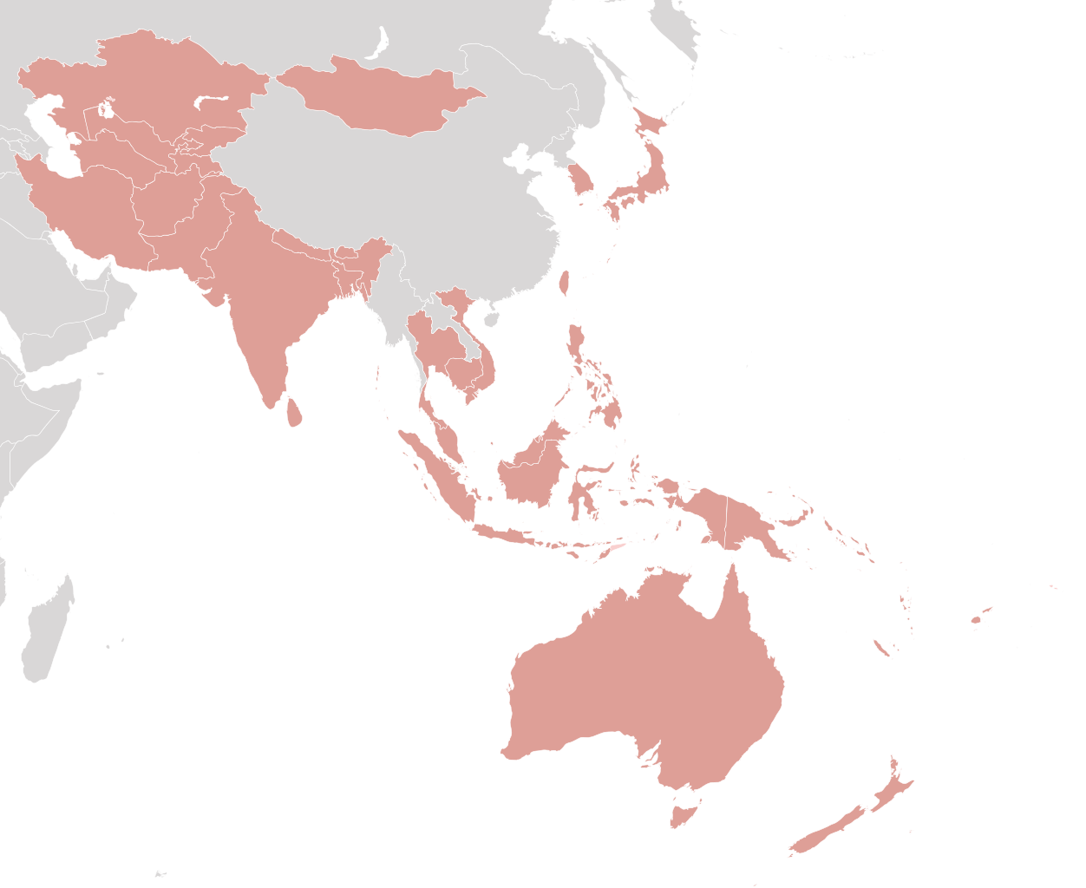
How
about
the Asia Pacific region?
This Photo by Unknown Author is licensed under CC BY-SA

Slide 40
Over the last 20 years, the Asia-Pacific region has
continued to keep high economic growth rates exceeding
those in other regions, and has consequently come to be known as the “growth center” of the global economy.
Over the coming years, it is expected to continue to enjoy
highest growth rates
in the world
and to serve as the engine
of the world economy.
Notes:
Recent Headlines
USE PHOTOS
ASEAN to become world’s fourth largest economy by 2030 – Singapore PM Lee
Singapore firms must team up to expand abroad, says Heng
HOW DO WE EXPAND THIS MARKET?
The only way forward is solidarity and unity of purpose!

Slide 41

Move forwards with
Solidarity and
Unity of Purpose
Notes:
HOW DO WE EXPAND THIS MARKET?
The only way forward is solidarity and unity of purpose!
A Sense of Solidarity

Slide 42

UBUNTU
I am because
you are
One person at a time
Notes:
Recent Headlines
USE PHOTOS
ASEAN to become world’s fourth largest economy by 2030 – Singapore PM Lee
Singapore firms must team up to expand abroad, says Heng
HOW DO WE EXPAND THIS MARKET?
The only way forward is solidarity and unity of purpose!

Slide 43


Seize the moment
The best is yet to be!

